Slide 1
Lead Scoring Case Study
- Tanzeel Iqbal & Rhituporna Sarkar

Slide 2
Problem Statement
Business Objectives
The typical lead conversion rate at X education is around 30%.
The CEO, in particular, has given a ballpark of the target lead conversion rate to be around 80%.
X Education has appointed you to help them select the most promising leads, i.e. the leads that are most likely to convert into paying customers.
The company requires you to build a model wherein you need to assign a lead score to each of the leads such that the customers with a higher lead score have a higher conversion chance and the customers with a lower lead score have a lower conversion chance.

Slide 3
Assumptions:
No assumptions

Slide 4
Approach adopted for Analysis:
Data cleaning and preparation
Checking Missing values
Handling categorical variables
Mapping categorical variables to integers
Dummy variable creation
Test-train split and scaling
Model Building
Feature elimination based on correlations
Feature selection using RFE (Coarse Tuning)
Manual feature elimination (using p-values and VIFs)
Model Evaluation
Accuracy
Sensitivity and Specificity
Optimal cut-off using ROC curve
Precision and Recall
Predictions on the test set

Slide 5
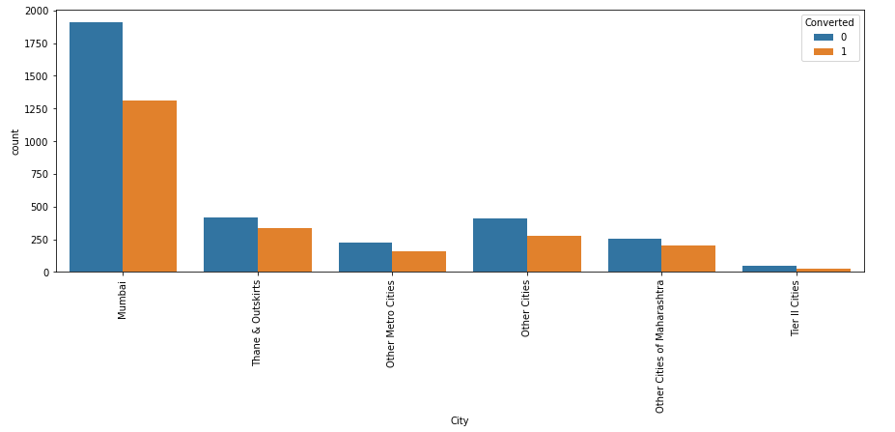
Analysis Performed:
Mumbai has higher conversion rate whereas tier 2 cities are among the lowest to take online courses.

Slide 6
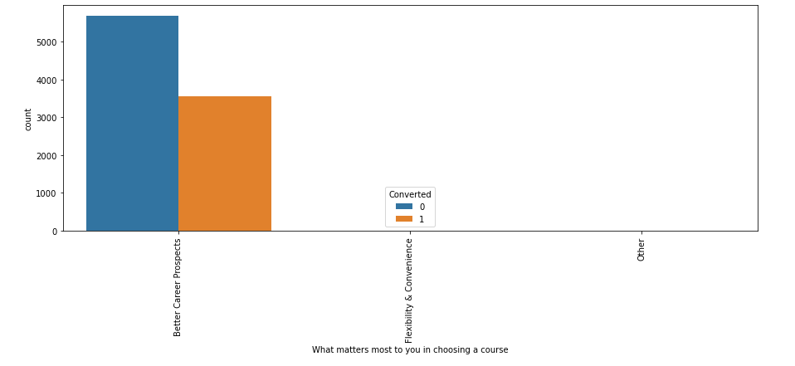
Analysis Performed:
The reason behind taking the course is ‘Better Career Prospects’

Slide 7
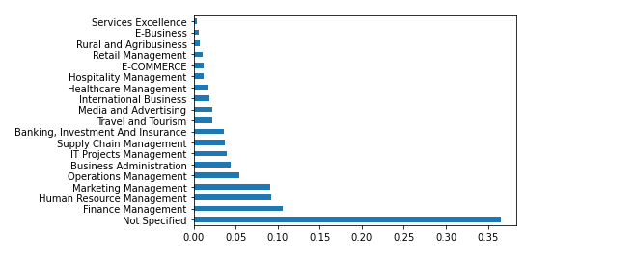
Analysis Performed:
From the below graph it is evident a huge number of people have not specified their specialization. However, the second highest leads are from ‘Finance Management’ followed by ‘Marketing’ and ‘Human Resource Management’.

Slide 8
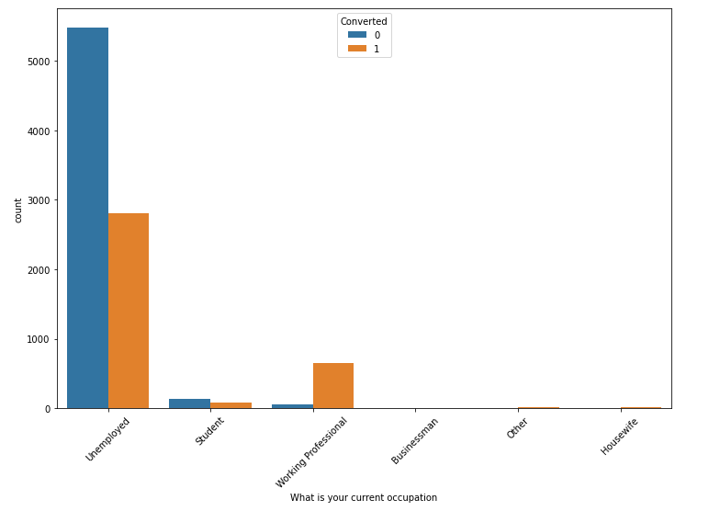
Analysis Performed:
The below graph shows that the conversion rates from leads to customer is highest for unemployed people followed by working professional.

Slide 9
Conclusion:
The Sales team should focus on leads who are particularly working professionals.
The team should reach out to people whose last activity was to have a phone conversation with the sales team.
When the lead origin is through lead add form, the sales team should concentrate on such leads.
The sales team can focus on leads who has spent quite a lot of team in website and target them.

